Slide 1

Employee Management System

Slide 2

INTRODUCTION
Full Stack Application – Employee Management System
Employee management system is a distributed application develop to maintain the details of employees working in any organization.
The EMS has been developed to override the problems prevailing in the practicing manual system.
It maintains the information about the personal and official details of the employees.

Slide 3
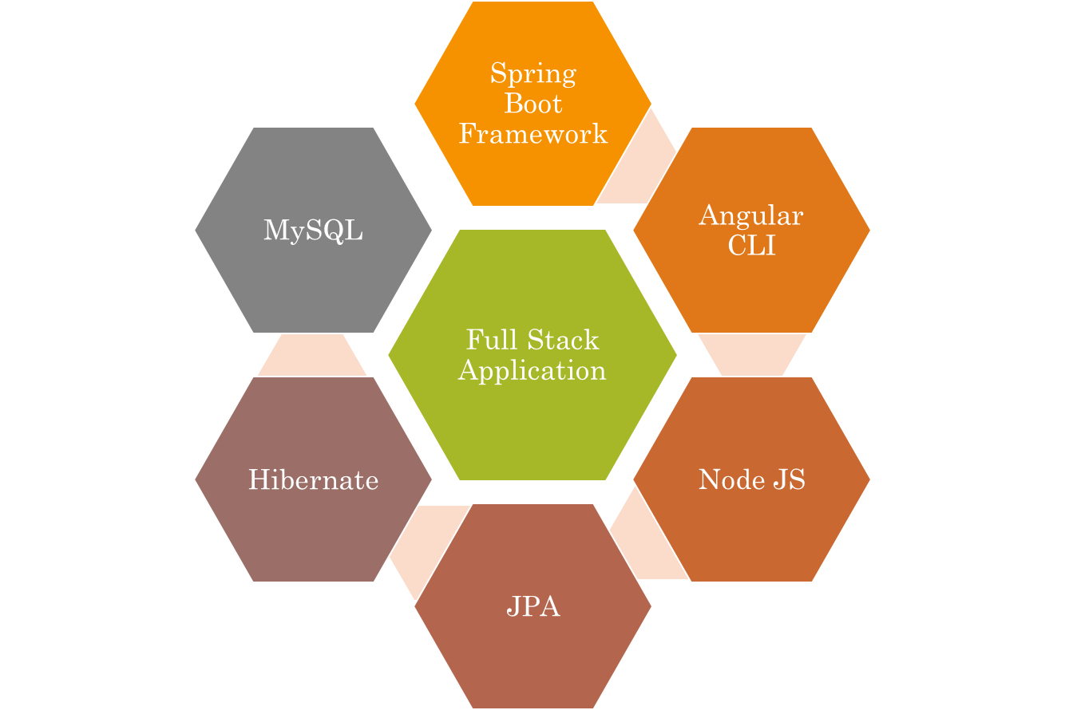
Technologies used

Slide 4
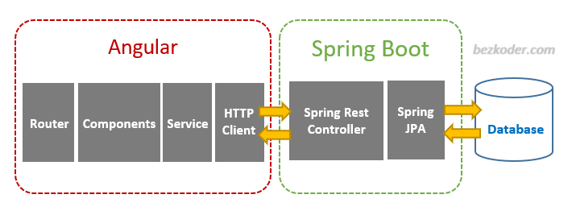


The Architecture of Angular, Spring
& database(MySQL)

Slide 5
The Architecture of the Project
Angular JS
Node JS
Frontend
Spring Boot
Backend
MySQL

Slide 6
CRUD Operations
View
Employee Record
Update Employee
Delete Employee
CRUD
Add Employee

Slide 7
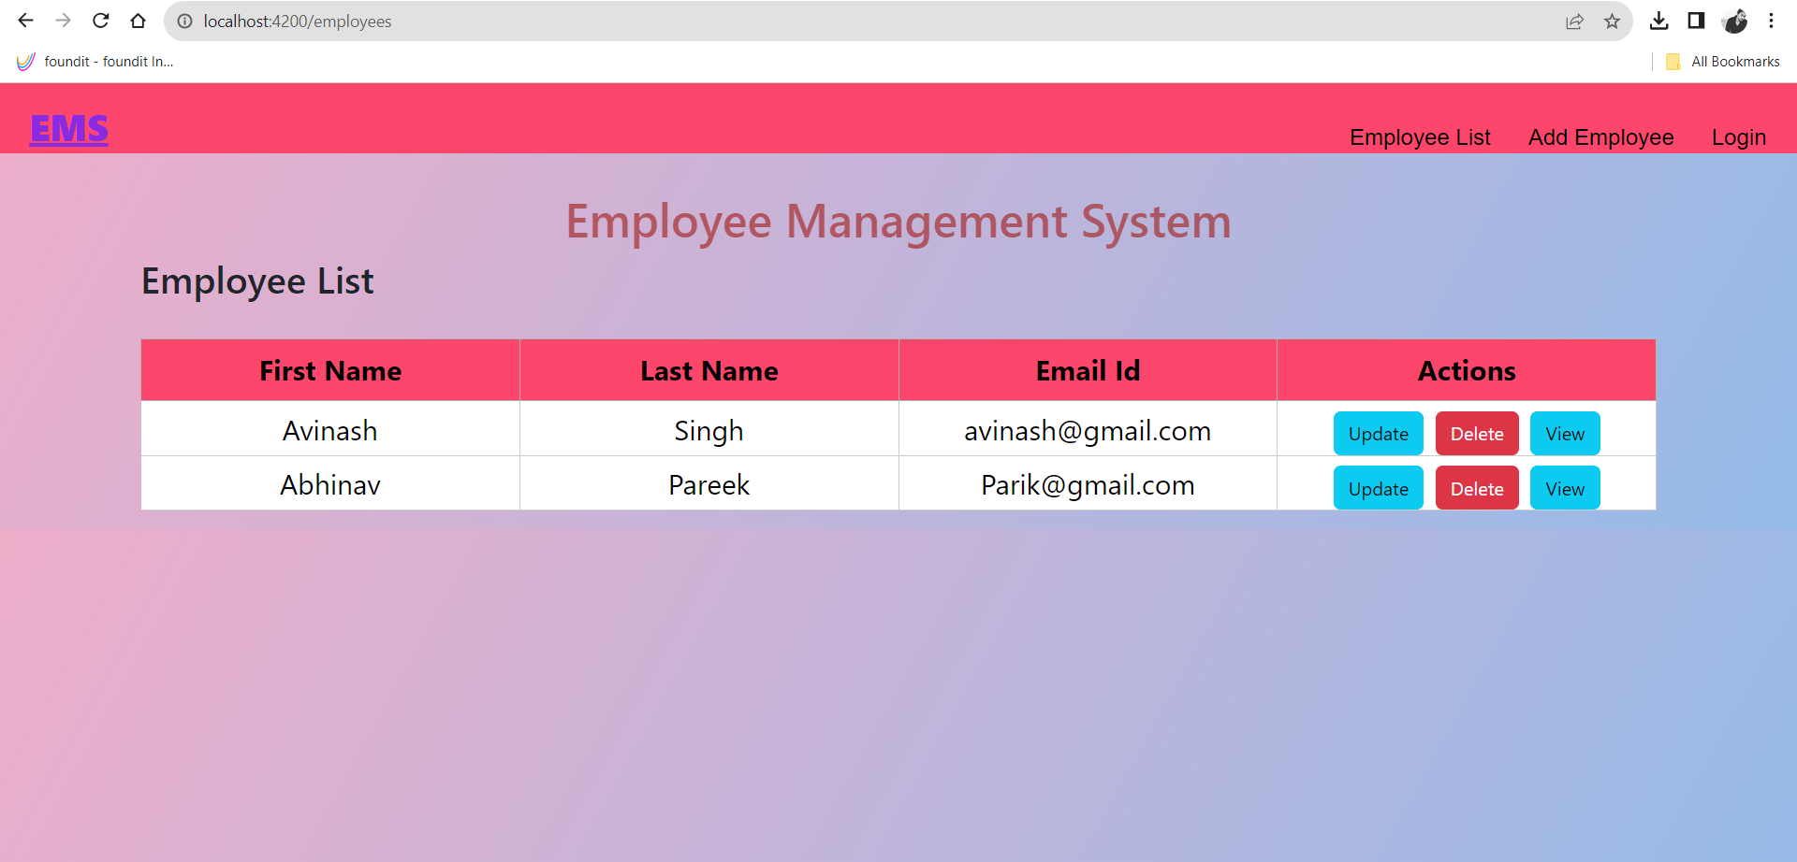
Home Page

Slide 8
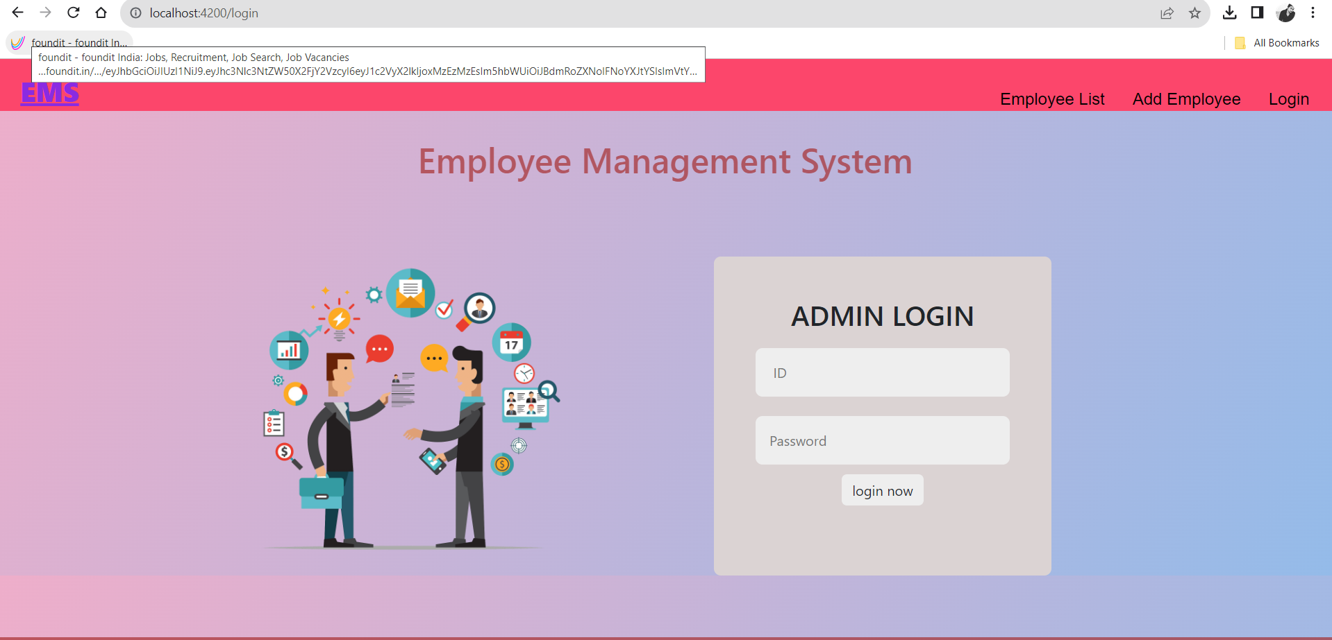
Login Page

Slide 9
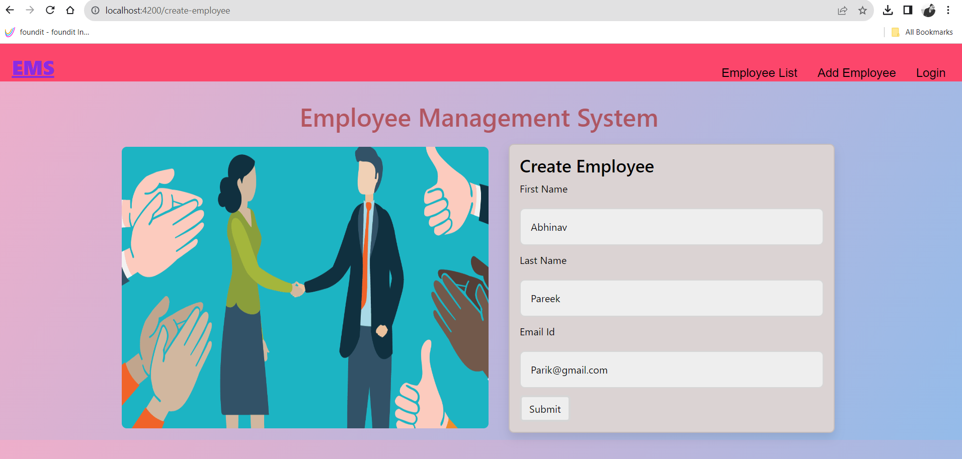
Create Page

Slide 10
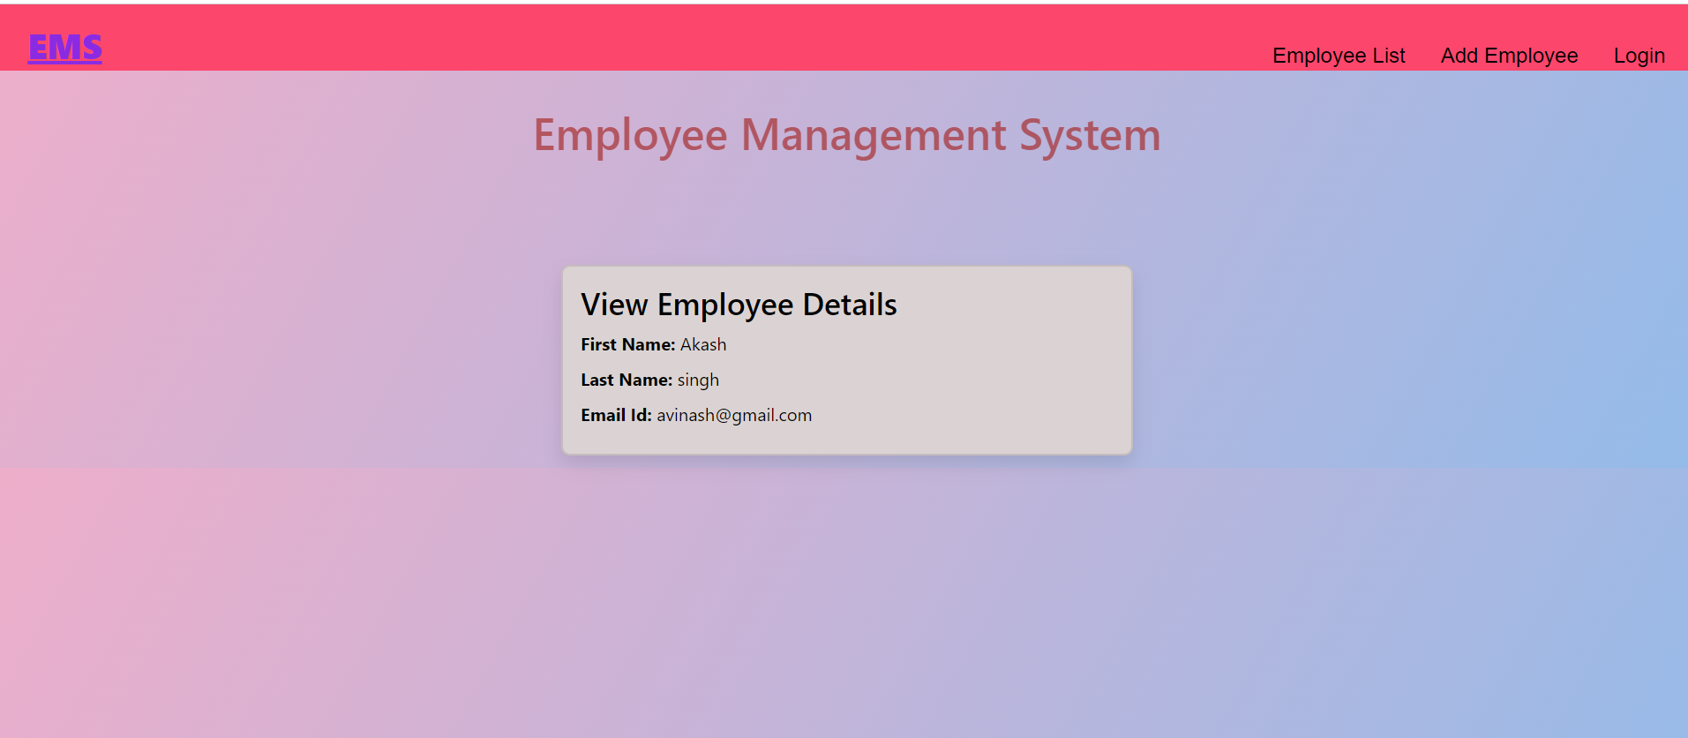
View Page

Slide 11
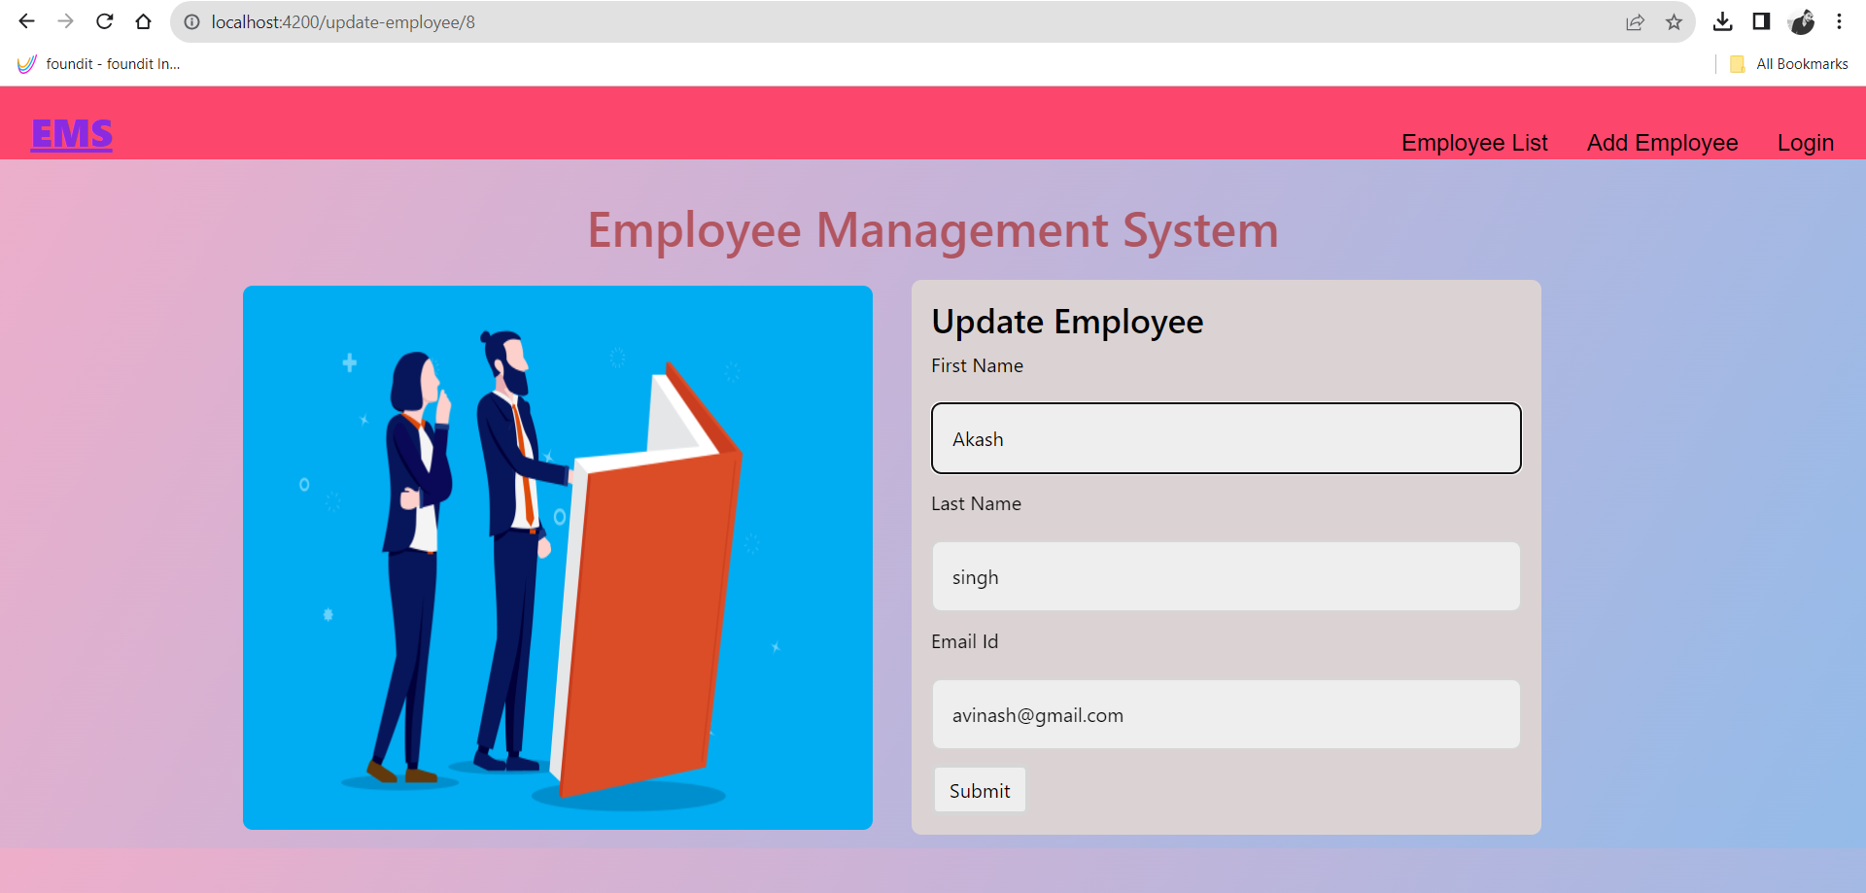
Update Page

Slide 12
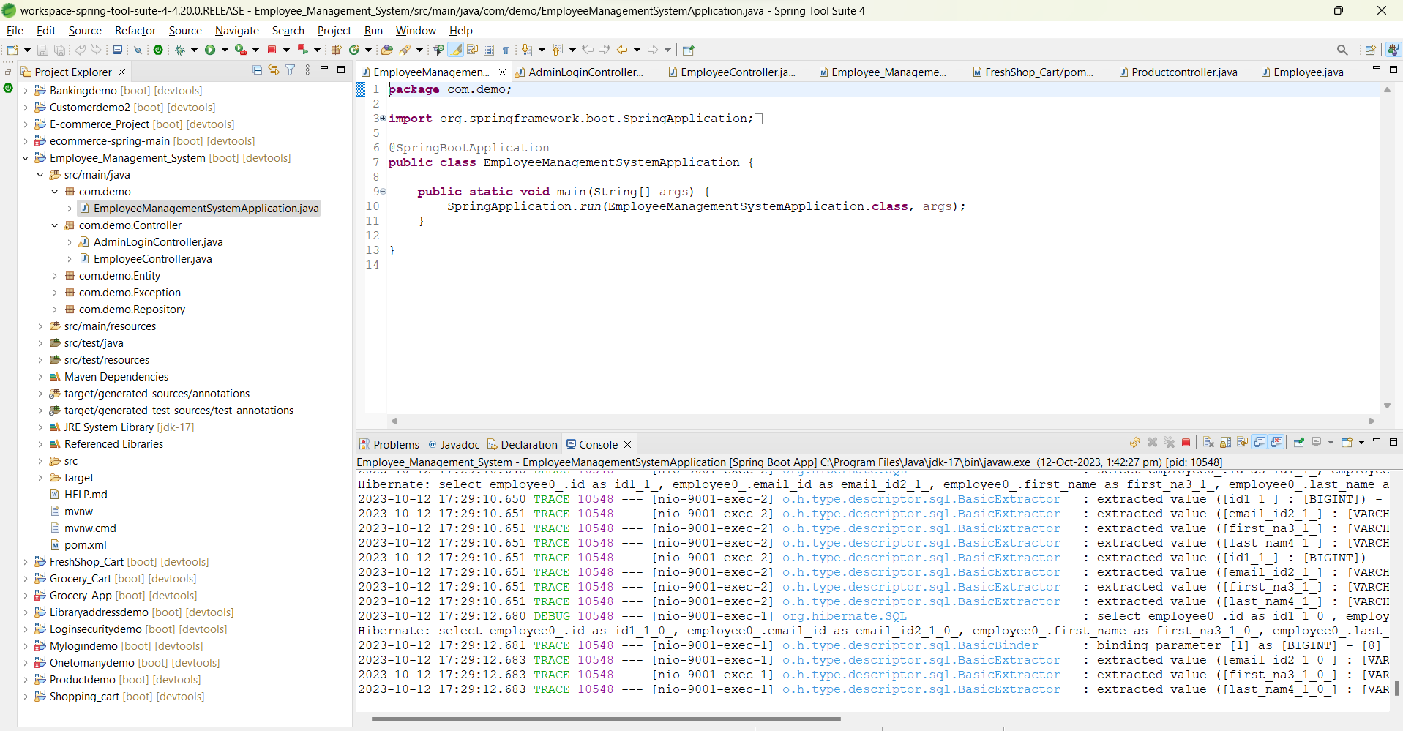
Spring Boot Application

Slide 13
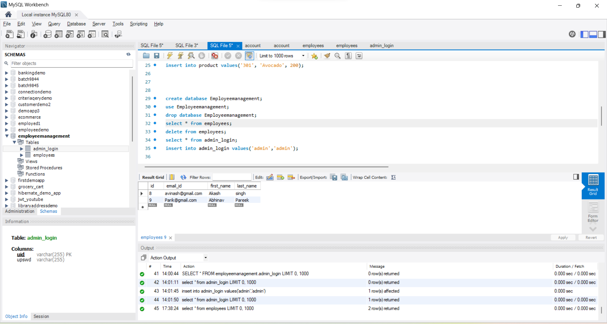
My SQL Code

Slide 14
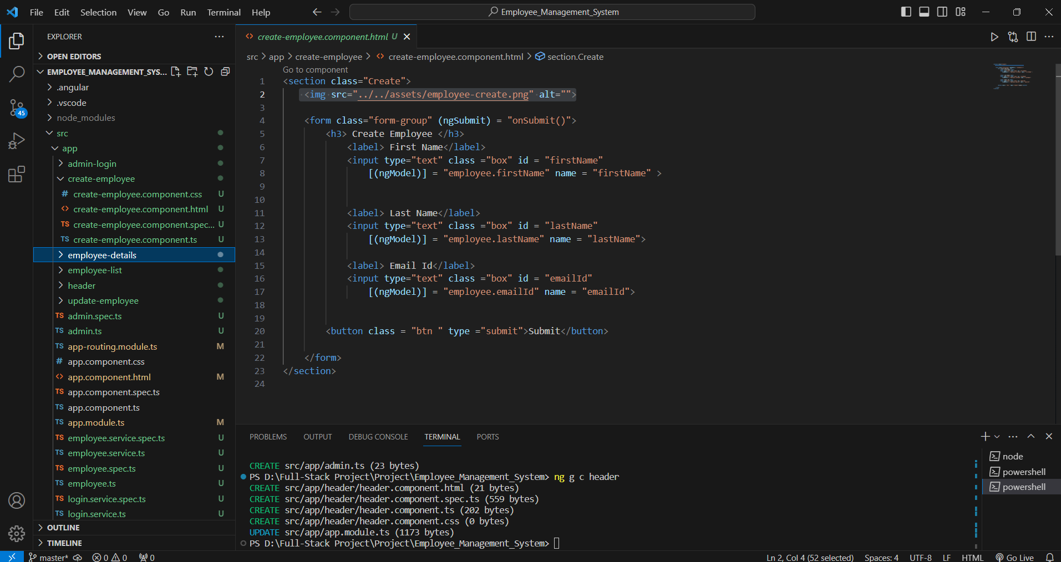
Angular Js Code

Slide 15

Future Scope
Since employee management utilizes massive data sets, AI for employee management can assess and predict one's behavior and prevent unwanted situations, like an employee's leave. This, in turn, will assist in increasing the company's profitability and performance

Slide 16

GitHub Link

Slide 17
Thank you.

